Slide 1



Music Notation generation
Asahi Cantu
Tim Bauerle
https://github.com/dat550-2021/DeepWhiners

Slide 2
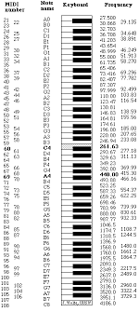
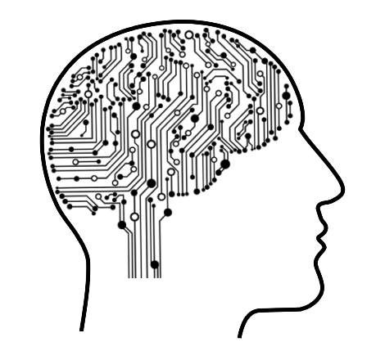
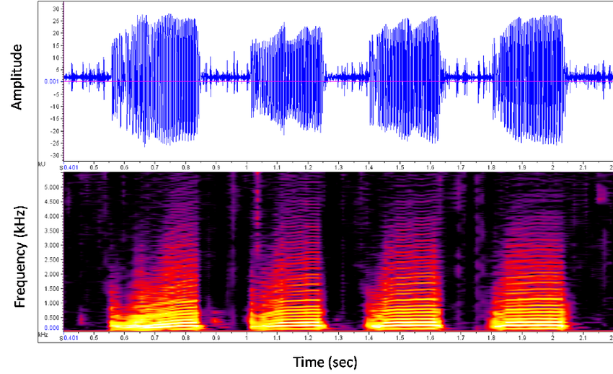
Introduction
MIDI
Music Composition
Music Genre Classification
Instrument recognition
Audio Synthesis
MUSIC TRANSCRIPTION
Audio Analysis
Notes:
We can highlight the history of music after napster
https://www.theguardian.com/music/2019/may/31/napster-twenty-years-music-revolution
Music and piracy
https://visual.ly/community/infographic/entertainment/music-and-piracy

Slide 3
Problem statement
With the use of different machine learning techniques and through audio analysis, it is possible to generate a model capable of “listening” to an audio file and generate the musical transcription equivalent

Slide 4
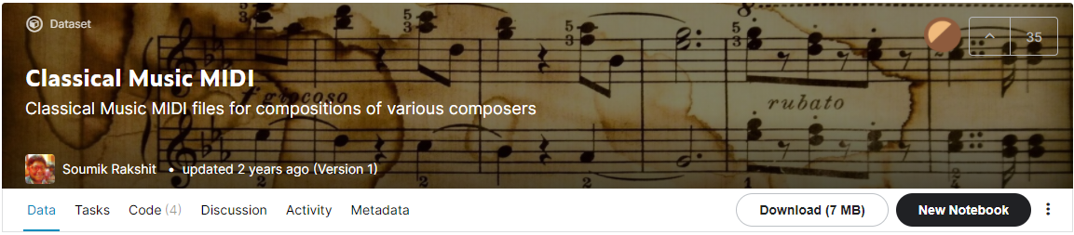
DataSet
Classical Music MIDI
~7MB
295 Files
Sources
https://www.kaggle.com/soumikrakshit/classical-music-midi

Slide 5
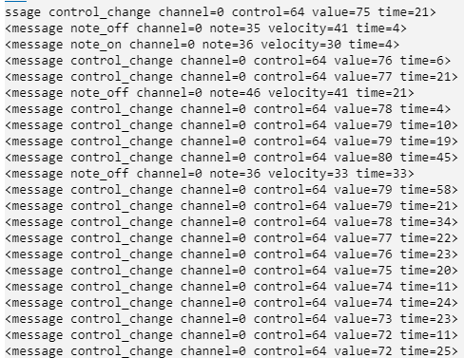
Data Pre-processing worfklow
MIDI MESSAGES
Split into Sets of 1/16 time period

Slide 6
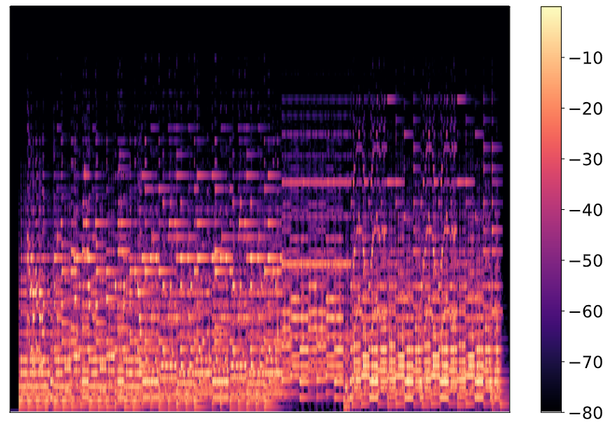
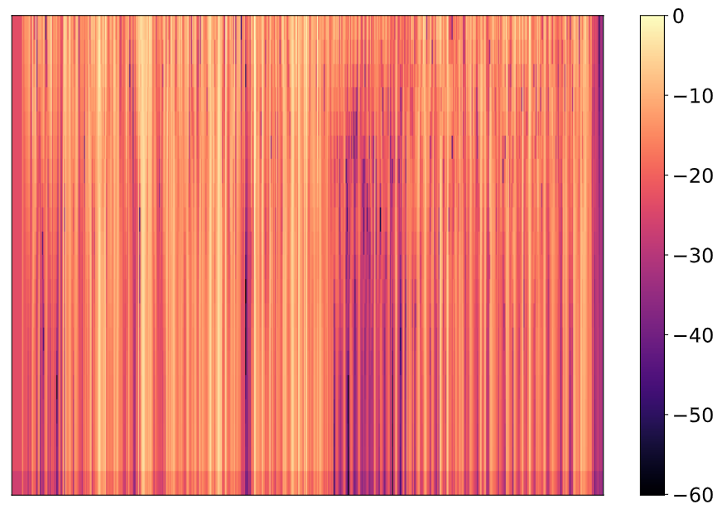
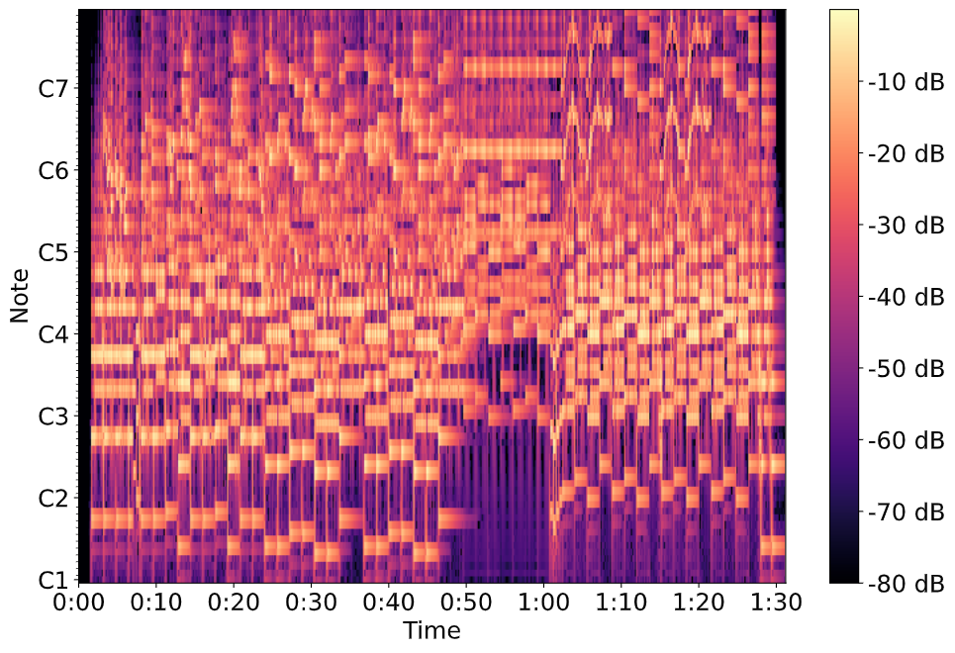
Data Pre-processing worfklow
Audio analysis - Spectrogram extraction
MEL Frequency
Cepstral Coefficients
MFCC
MEL
Constant Q-Transform
CQT

Slide 7
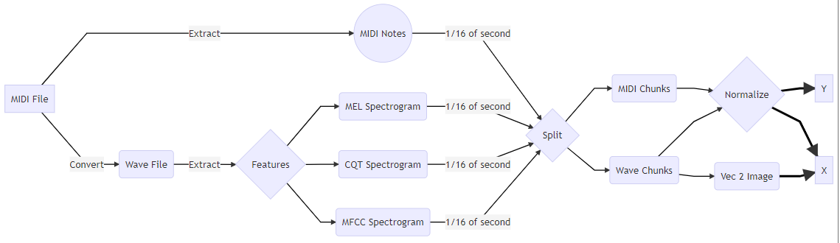
Data Pre-processing worfklow

Slide 8
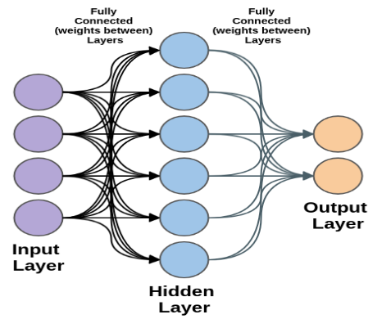
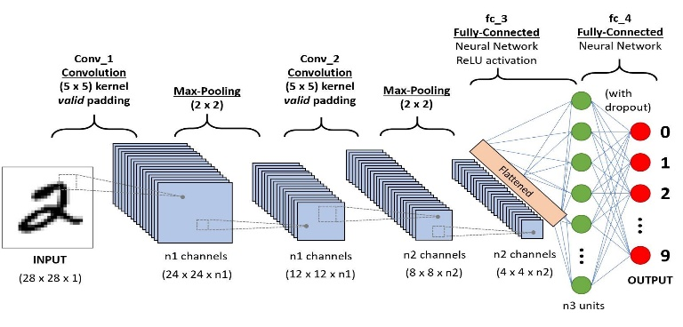
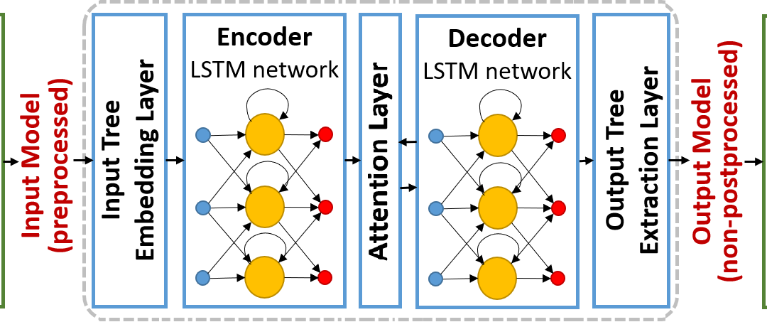
Neural Network architectures
Multilayer perceptron
Convolutional Neural Network
CNN – MNIST
CNN-MNIST CUSTOM
ALEXNET
Long Short-Term Memory
LSTM
LSTM – Time Distributed

Slide 9
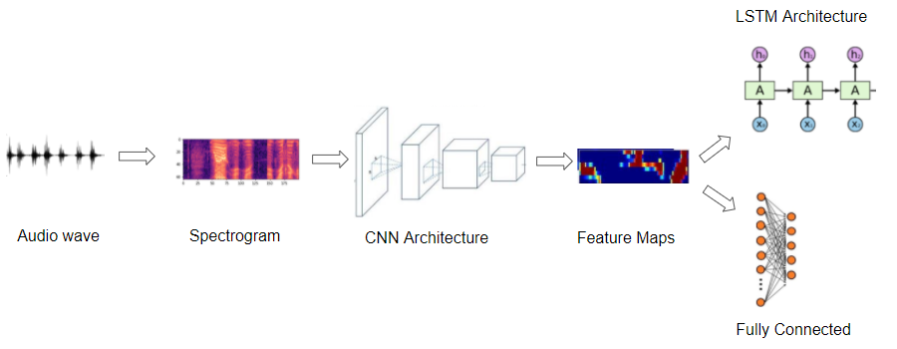

Slide 10
Related Works

Slide 11

Challenges and results

Slide 12
Expected results

Slide 13
Future Works

